Slide 1
Random Forest Documentation
http://www.stat.berkeley.edu/~breiman/RandomForests/cc_home.htm
The Random Forest description for the link above is clear.
The website also has many links to pursue. For example see
http://www.stat.berkeley.edu/~breiman/RandomForests/ENAR_files/frame.htm
Topics include
Fast and then better imputation of missing values.
Some data examples
Weak learners and the power averaging independent learns
Finding outliers via proximities
Much of text below is from document with the above link. I should add
more quotes below. My own wording below may not be as good.
My good is tp draw more attention to their work, not take credit for it.
Most of graphics here use functions from the R randomForest package.
There are many ways to look at the results provided by Random Forests.

Slide 2
Overview: Tree Growth
RF mean Random Forests. The data is a training data set.
Case sampling for each tree
RF samples cases with replacement leaving out about one-third of the cases.
RF calls not-selected cases out-of-bag (oob) cases. These are use for:
1) unbiased estimates of classification errors as trees are added to the forest
2) variable importance
Variable sampling for each node
RF randomly selects m of the M variables in the data set
to assess the splitting of cases at each a node of the tree
RF selects the best split: both the variable and the value
The number m is constant for all trees and nodes.
R’s RF function has an argument m with default values.
Classification: m ≈ sqrt(M), Regression: m ≈ M/3 (need to verify)
Tree growth
RF grows each classification tree to the largest extent possible.
*Regression trees have a default minimum leaf node size of 5.
There is no pruning.

Slide 3
Iris Data Set
The iris data set has 150 cases.
It has 5 variables, 4 predictors and the iris species variable with 3 classes
Sepal.Length Sepal.Width Petal.Length Petal.Width Species
1 5.1 3.5 1.4 0.2 setosa
2 4.9 3.0 1.4 0.2 setosa
3 4.7 3.2 1.3 0.2 setosa
51 7.0 3.2 4.7 1.4 versicolor
101 6.3 3.3 6.0 2.5 virginica

Slide 4
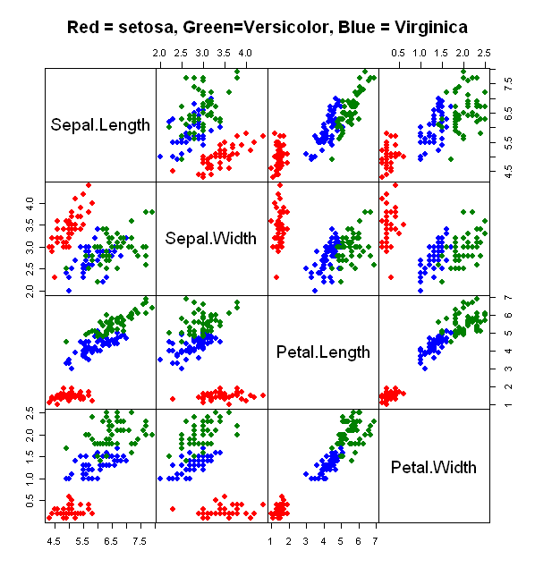

Slide 5
Example R script for a Classification Model
In R’s RF function we specify the predictors variables using the x argument.
We specify the class variable with the y argument.
irisRf <- randomForest( x = iris[, -5], y = iris[, 5],
keepForest = TRUE, proximity = TRUE)
As indicated above the class variable is the 5th variable in the iris data matrix.
I chose to keep the forest to show the first tree as an example below.
I fairly often choose to keep the proximity matrix for later use.
Other useful options are to obtain variable and local variable importance.

Slide 6
One Iris Tree Table of the 500
Node ID | Left Child | Right Child | Split Var | Split point | Status -1 = Leaf | Predicted Class
1 | 2 | 3 | 4 | 0.80 | 1 | 0
2 | 0 | 0 | 0 | 0.00 | -1 | 1
3 | 4 | 5 | 4 | 1.65 | 1 | 0
4 | 6 | 7 | 4 | 1.35 | 1 | 0
5 | 8 | 9 | 1 | 6.05 | 1 | 0
6 | 0 | 0 | 0 | 0.00 | -1 | 2
7 | 10 | 11 | 3 | 4.95 | 1 | 0
8 | 12 | 13 | 3 | 4.85 | 1 | 0
9 | 0 | 0 | 0 | 0.00 | -1 | 3
10 | 0 | 0 | 0 | 0.00 | -1 | 2
11 | 0 | 0 | 0 | 0.00 | -1 | 3
12 | 14 | 15 | 1 | 5.40 | 1 | 2
13 | 0 | 0 | 0 | 0.00 | -1 | 3
14 | 0 | 0 | 0 | 0.00 | -1 | 3
15 | 0 | 0 | 0 | 0.00 | -1 | 2
1= Root Node
Leaf Nodes
Variables: 1 = Sepal.L, 2 = Sepal.W, 3 = Petal.L, 4 = Petal.W
Classes: 1 = Setosa, 2 = Versicolor, 3= Virginia

Slide 7
The out-of-bag (oob) error estimate
RF puts each oob case for the k^{th} tree down the k^{th} tree to get a its classification .
RF will classify each case in about one-third of the trees
For each case let j be the class that gets most votes when the case is oob.
OOB error rate estimate is the proportion cases with j not equal to the true class
RF also computes the class.error rates using the class specific cases
“This has proven to be unbiased in many tests.”
Below rows are the training data classes and columns are predicted classes
Iris Data, 500 trees
OOB estimate of error rate: 4.67%
Confusion matrix:
setosa versicolor virginica class.error
setosa 50 0 0 0.00
versicolor 0 47 3 0.06
virginica 0 4 46 0.08

Slide 8
Classification Variable Importance
Classification Accuracy
In every tree grown in the forest, put down the oob cases and count the number of votes cast for the correct class.
Now randomly permute the values of variable m in the oob cases and put these cases down the tree.
Subtract the number of votes for the correct class in the variable-m-permuted oob data from the number of votes for the correct class in the untouched oob data.
The average of this number over all trees in the forest is the raw importance score for variable m.
Gini impurity
Every time a split of a node is made on variable m the Gini impurity criterion for the two descendent nodes is less than the parent node.
Adding up the Gini decreases for each individual variable over all trees in the forest gives a fast assessment variable importance

Slide 9
Gini Impurity and Categorical Variable Deviance
The decision tree learning Gini impurity measure
We will not discuss the general Gini index used for other purposes
We can interpret the Gini impurity as the probability of being wrong if we
randomly predict a case classes based on the fraction of cases in each class.
For each class i, let Pi be the fraction of cases in class i.
The probability being class in i is Pi and the probability of being wrong is 1-Pi
The expect error rates is ∑ Pi*(1-Pi) = 1 - ∑ Pi**2
If there is only 1 class the Gini impurity is 0.
Some tree models use the deviance as a splitting criterion
Deviance is the -2 log likelihood ratio comparing two models, the model and
the split model.
The models can be based on the multinomial distribution.
The key part of the log likelihood appears on the next page along
with its connection to entropy.

Slide 10
Three Categorical Splitting Criteria
Suppose the node has people in three classes: Hostile, Unstable, and Safe
Label: | Hostile | Unstable | Safe
Ni | 20 | 80 | 900 | N=1000
Proportion | .02 | .08 | .900 | 1
Pi | P₁ = .02 | P₂ = .08 | P₃=.90
Three Criteria
RF Gini Index: 1 – ∑ Pi **2 = 1 - (.02**2 + .08**2 + .9**2) = 0.1832
Multinomial log likelihood: ∑ Ni*log(Pi)
Entropy ∑ Pi*log(Pi)
Note 1: Terms with Ni or Pi = 0 are excluded from the computation
Note 2: Since Pi = Ni/N the last two criteria yield equivalent results

Slide 11
Gini Impurity Example: Iris Data
Node ID | Left Child | Right Child | Split Var | Split point | Status -1 = Leaf | Predicted Class
1 | 2 | 3 | 4 | 0.80 | 1 | 0
2 | 0 | 0 | 0 | 0.00 | -1 | 1
3 | 4 | 5 | 4 | 1.65 | 1 | 0
Gini <- function(x) 1- (x/sum(x))**2
class <- iris[, 5]
# Node 1
tab <- table(class)
tab
setosa versicolor virginica
50 50 50
Gini(tab) # 0.6666667
# Node 2: left child
# table value .80 was rounded
g1 <- iris[, 4] <= .801
table( class[g1])
setosa versicolor virginica
50 0 0
# Gini = 0
# Node 3: right child
tab <- table( class[!g1])
setosa versicolor virginica
0 50 50
Gini(tab)
0.5
# 0.5 + 0 < .6666667
# Node 4: left child of Node 3
g3 <- !g1 & iris[,4] <= 1.65
tab <- table( class[g3] )
tab
setosa versicolor virginica
0 48 4
Gini(tab)
0.142

Slide 12
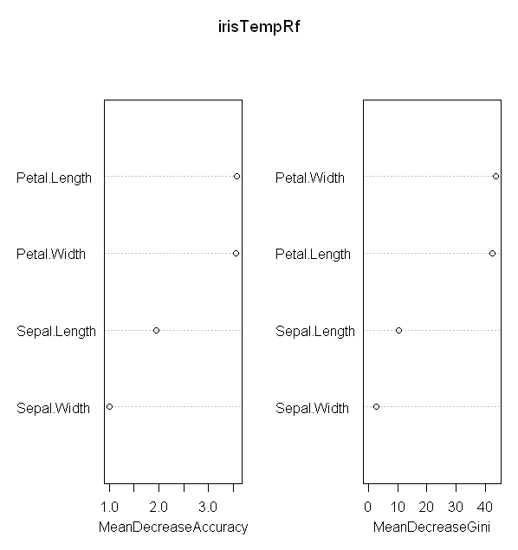
Classification: Iris Variable Importance

Slide 13
Proximities
Proximities are one of the most useful tools in random forests.
The proximities originally formed a N x N matrix.
After a tree is grown, put all of the data, both training and oob, down the tree. If cases k and n are in the same terminal node increase their proximity by one. At the end, normalize the proximities by dividing by the number of trees.
Prototypes
Prototypes are a way of getting a picture of how the variables relate to the classification.
For the j^{th} class, find the case that has the largest number of class j cases among its k nearest neighbors, determined using the proximities. Among these k cases we find the median, 25th percentile, and 75th percentile for each variable. The medians are the prototype for class j and the quartiles give an estimate of its stability.

Slide 14
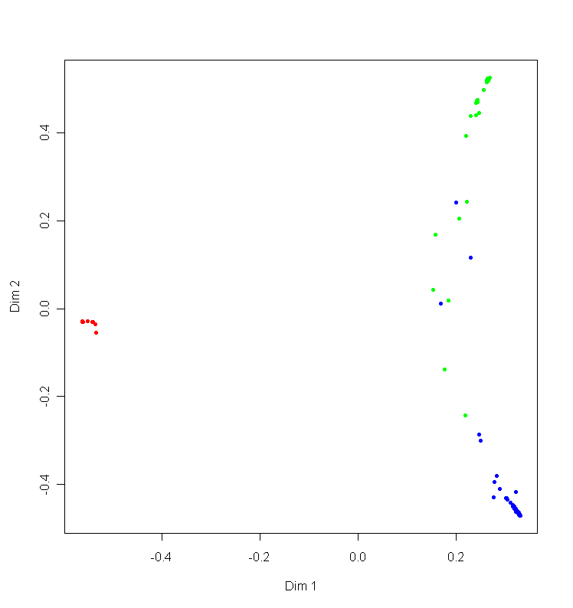
Multidimensional scaling of points into 2D based proximity matrix.
Many red points are overplotted

Slide 15
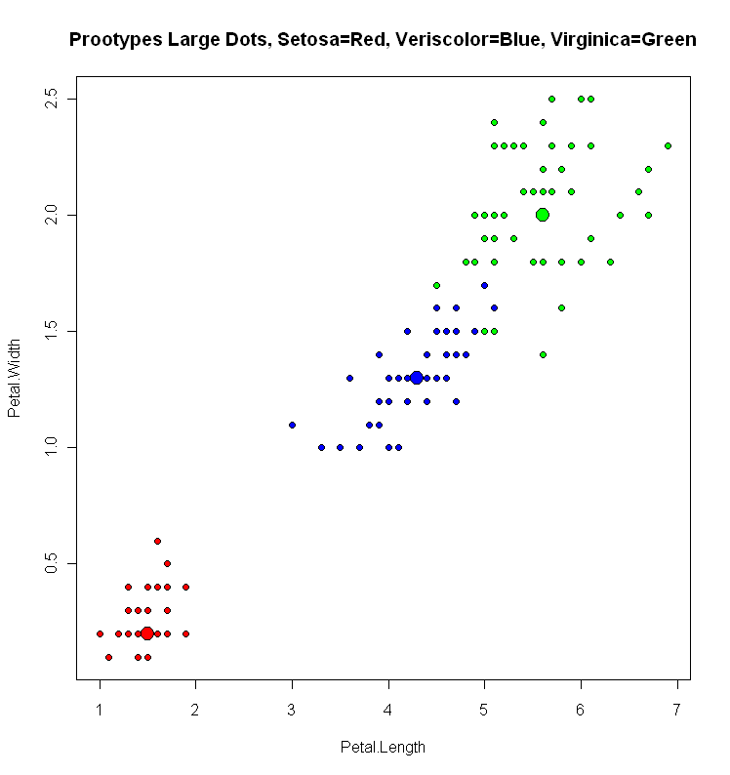
Prototype Example

Slide 16
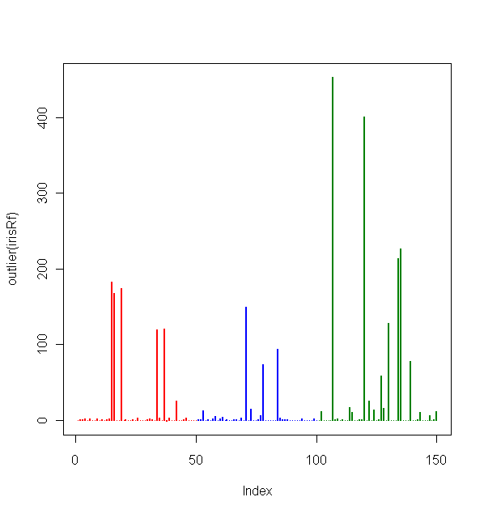
Outlier Measure
The outlier measure for a case is computed as n/sum(squared proximity),
normalized by subtracting the median and divided by the MAD, within each class.

Slide 17
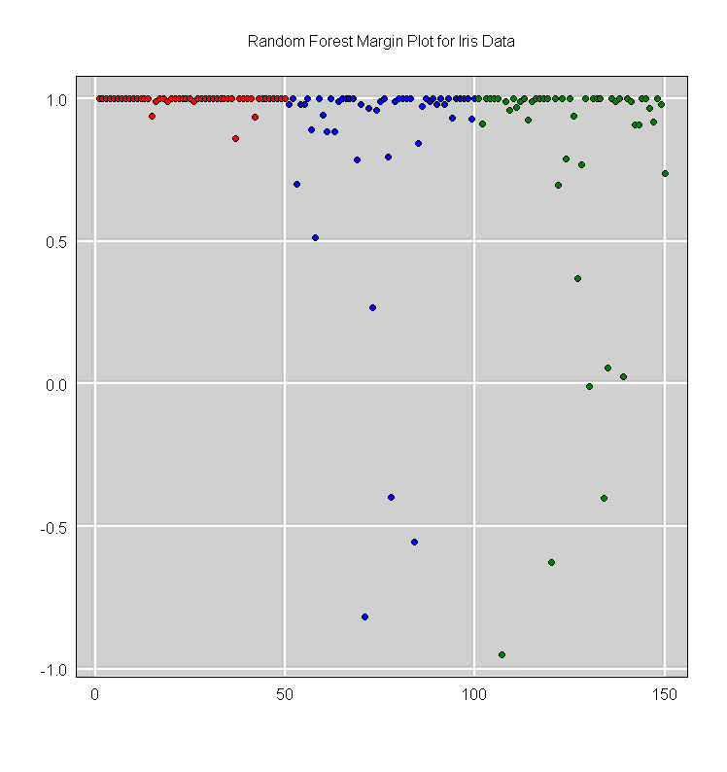
Margin Plot for Cases
Fraction of votes for Correct Class – Fraction for 2nd Highest Class

Slide 18
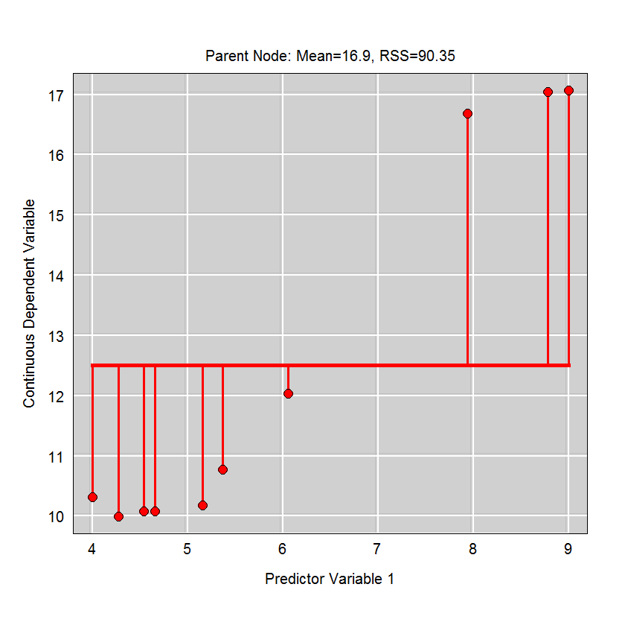
Regression Example: Node Predicted Value Is the Mean

Slide 19
Regression: Node Splitting Based on Residual Sum of Squares
Left Pts | Left Mean | Left RSS | Right Mean | Right RSS | Total RSS
1 | 10.3 | .00 | 12.7 | 85.39 | 85.39
1:2 | 10.1 | .05 | 13.0 | 77.38 | 77.43
1:3 | 10.1 | .05 | 13.4 | 67.67 | 67.72
1:4 | 10.1 | .06 | 14.0 | 54.76 | 54.82
1:5 | 10.1 | .06 | 14.7 | 37.55 | 37.61
1:6 | 10.2 | .40 | 15.7 | 18.04 | 18.44
1:7 | 10.5 | 3.19 | 16.9 | .09 | 3.29
1:8 | 11.3 | 36.71 | 17.1 | .00 | 36.71
1:9 | 11.9 | 66.35 | 17.1 | .00 | 66.35

Slide 20
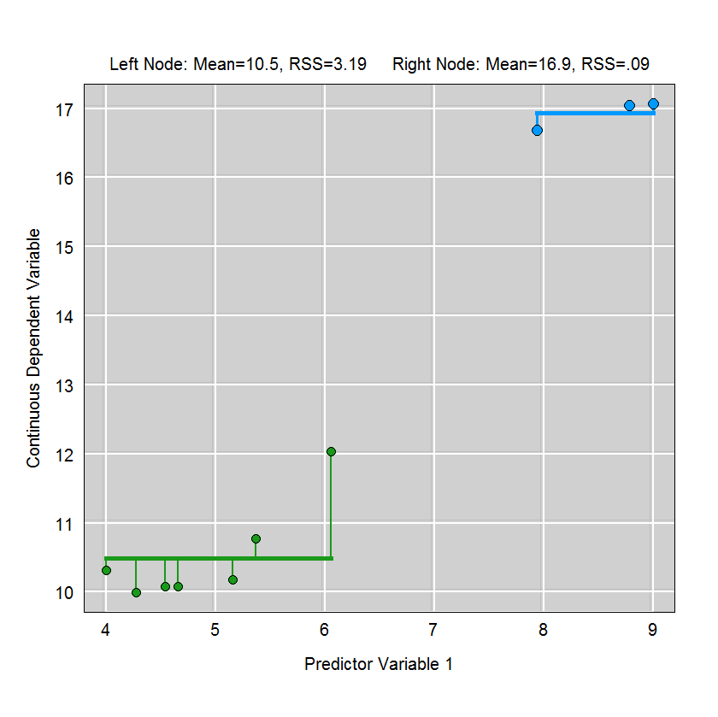
Regression: Node Splitting Based on Residual Sum of Squares

Slide 21
Regression Variable Importance
Mean square error
“For each tree, the prediction error on the out-of-bag portion of the data is recorded.
Then the same is done after permuting each predictor variable. “
For each predictor variable difference between permuted and original prediction errors are averaged over all trees, and normalized by the standard deviation of the differences.
( If the standard deviation of the differences is equal to 0 for a variable, the division is not done but the average is almost always equal to 0 in that case).
Residual sum of squares
This used total decrease in node impurities from splitting on the variable, averaged over all trees. For regression, impuritity is the residual sum of squares.

